Slide 1
Introduction to Data Science Overview

Slide 2
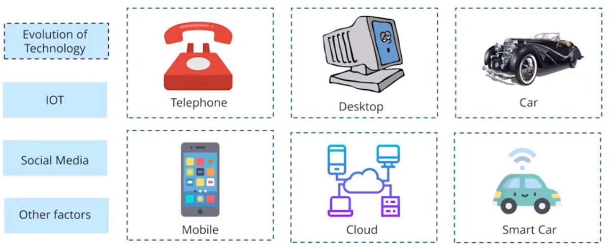
Data Source
Evolution of Technology has generated a lot of data, where most of these data are not structured.
Internet Of Thing (IOT) produces huge amount of data that is measured in Zettabyte (a unit of information equal to one sextillion (10²¹) or, strictly, 2⁷⁰ bytes.)

Slide 3
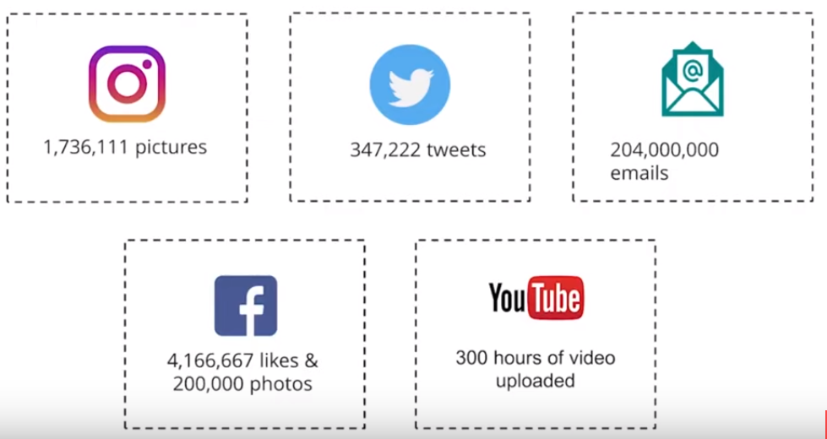
Data Source

Slide 4
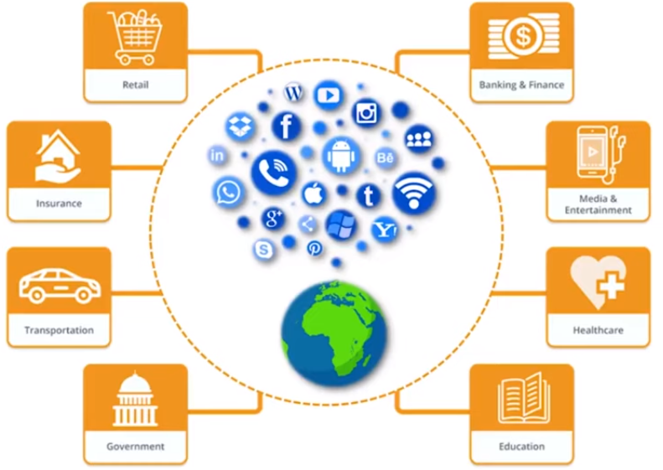
Data Source
Therefore, we can not rely on the traditional data processing systems

Slide 5
What is Data Science?
Data Science is the area of study which involves extracting insights from vast amounts of data by the use of various scientific methods, algorithms, and processes. It helps you to discover hidden patterns from the raw data.
The term Data Science has emerged because of the evolution of mathematical statistics, data analysis, and big data.
Data Science is an interdisciplinary field that allows you to extract knowledge from structured or unstructured data. Data science enables you to translate a business problem into a research project and then translate it back into a practical solution.

Slide 6

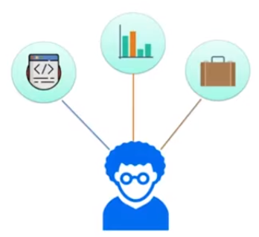


Slide 7
Why Data Science?
Here, are significant advantages of using Data Analytics Technology:
Data is the oil for today's world. With the right tools, technologies, algorithms, we can use data and convert it into a distinctive business advantage.
Data Science can help you to detect fraud using advanced machine learning algorithms.
It helps you to prevent any significant monetary losses.
Allows to build intelligence ability in machines.
You can perform sentiment analysis to gauge customer brand loyalty.
It enables you to take better and faster decisions.
Helps you to recommend the right product to the right customer to enhance your business.

Slide 8
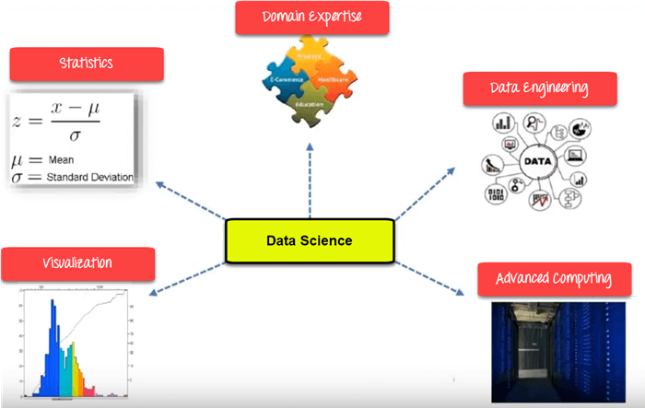
Data Science Components

Slide 9
Data Science Components
1. Statistics:
Statistics is the most critical unit in Data science. It is the method or science of collecting and analyzing numerical data in large quantities to get useful insights.
2. Visualization:
Visualization technique helps you to access huge amounts of data in easy to understand and digestible visuals.
3. domain expert
is a person who is an authority in a particular area or topic. The term domain expert is frequently used in expert systems software development, and there the term always refers to the domain other than the software domain. A domain expert is a person with special knowledge or skills in a particular area of endeavour (e.g. an accountant is an expert in the domain of accountancy). The development of accounting software requires knowledge in two different domains: accounting and software.

Slide 10
Data Science Components
4. Data Engineer
A data engineer is a worker whose primary job responsibilities involve preparing data for analytical or operational uses. The specific tasks handled by data engineers can vary from organization to organization but typically include building data pipelines to pull together information from different source systems; integrating, consolidating and cleansing data; and structuring it for use in individual analytics applications.
5. Advanced Computing
The full complement of capabilities that support compute- and data-intensive research across the entire science and engineering spectrum, which are too expensive to be purchased by an individual research group or department and perhaps too expensive even for an individual research institution.
6. Machine Learning:
Machine Learning explores the building and study of algorithms which learn to make predictions about unforeseen/future data.
7. Deep Learning:
Deep Learning method is new machine learning research where the algorithm selects the analysis model to follow.

Slide 11
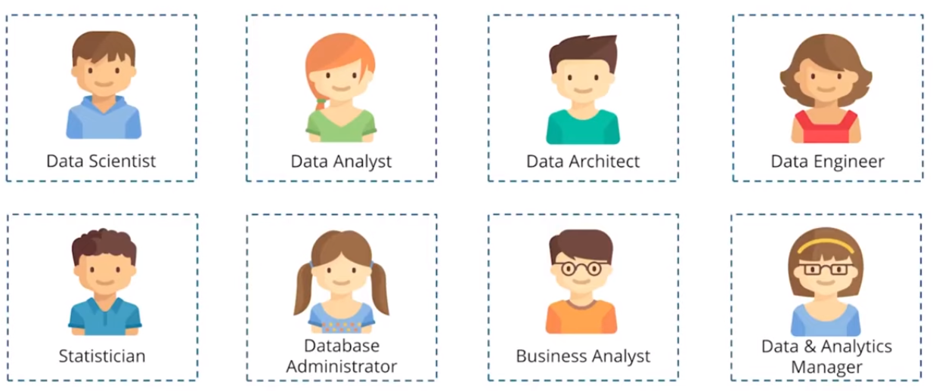
Data Science Jobs Roles
Most prominent Data Scientist job titles are:

Slide 12
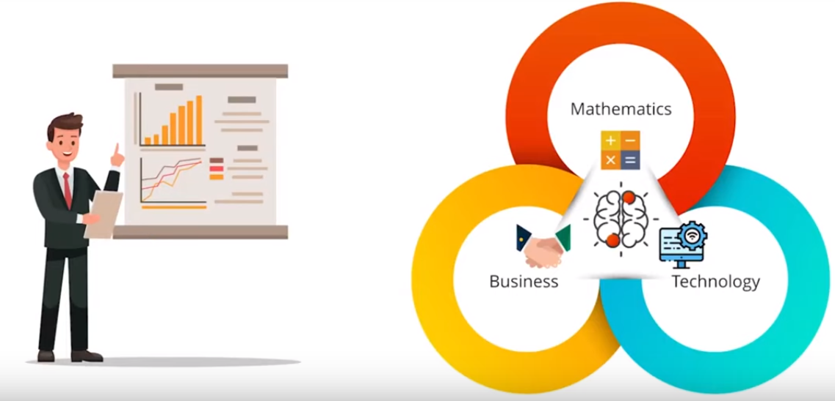
Data Scientist:
Role:
A Data Scientist is a professional who manages enormous amounts of data to come up with compelling business visions by using various tools, techniques, methodologies, algorithms, etc.
Languages:
R, SAS, Python, SQL, Hive, Matlab, Pig, Spark

Slide 13
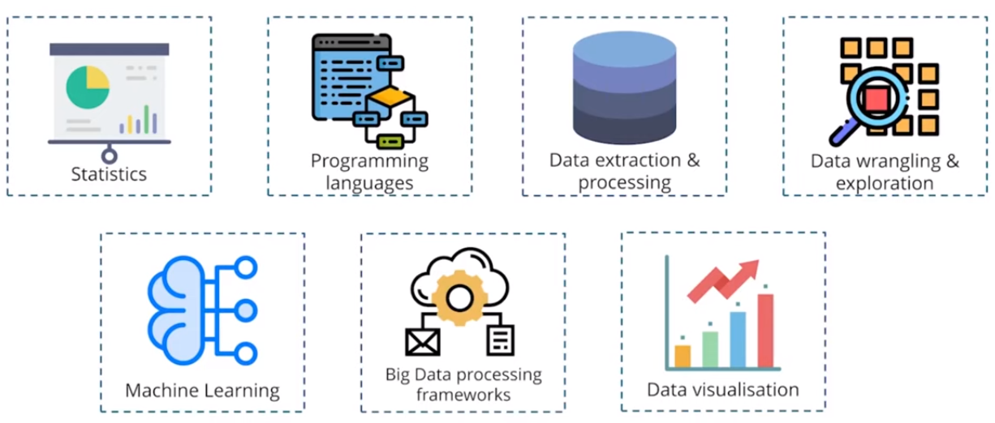
Data Scientist Skills List

Slide 14
Data Science Jobs Roles
Data Engineer:
Role:
The role of data engineer is of working with large amounts of data. He develops, constructs, tests, and maintains architectures like large scale processing system and databases.
Languages:
SQL, Hive, R, SAS, Matlab, Python, Java, Ruby, C + +, and Perl

Slide 15
Data Science Jobs Roles
Data Analyst:
Role:
A data analyst is responsible for mining vast amounts of data. He or she will look for relationships, patterns, trends in data. Later he or she will deliver compelling reporting and visualization for analyzing the data to take the most viable business decisions.
Languages:
R, Python, HTML, JS, C, C+ + , SQL
Statistician:
Role:
The statistician collects, analyses, understand qualitative and quantitative data by using statistical theories and methods.
Languages:
SQL, R, Matlab, Tableau, Python, Perl, Spark, and Hive

Slide 16
Data Science Jobs Roles
Data Administrator:
Role:
Data admin should ensure that the database is accessible to all relevant users. He also makes sure that it is performing correctly and is being kept safe from hacking.
Languages:
Ruby on Rails, SQL, Java, C#, and Python
Business Analyst:
Role:
This professional need to improves business processes. He/she as an intermediary between the business executive team and IT department.
Languages:
SQL, Tableau, Power BI and, Python

Slide 17
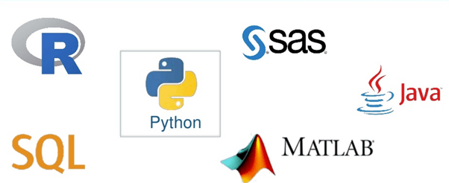
Tools for Data Science

Slide 18
Applications of Data science
Internet Search:
Google search use Data science technology to search a specific result within a fraction of a second
Recommendation Systems:
To create a recommendation system. Example, "suggested friends" on Facebook or suggested videos" on YouTube, everything is done with the help of Data Science.
Image & Speech Recognition:
Speech recognizes system like Siri, Google assistant, Alexa runs on the technique of Data science. Moreover, Facebook recognizes your friend when you upload a photo with them, with the help of Data Science.
Gaming world:
EA Sports, Sony, Nintendo, are using Data science technology. This enhances your gaming experience. Games are now developed using Machine Learning technique. It can update itself when you move to higher levels.
Online Price Comparison:
PriceRunner, Junglee, Shopzilla work on the Data science mechanism. Here, data is fetched from the relevant websites using APIs.

Slide 19
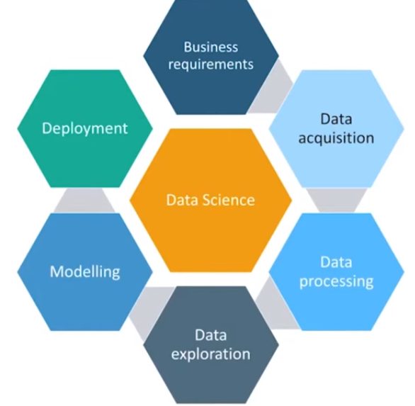
Data Science Life Cycle

Slide 20
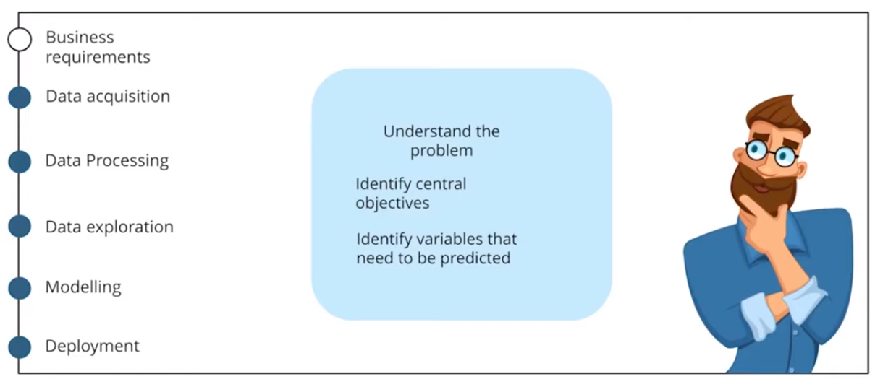
1. Business Requirements

Slide 21
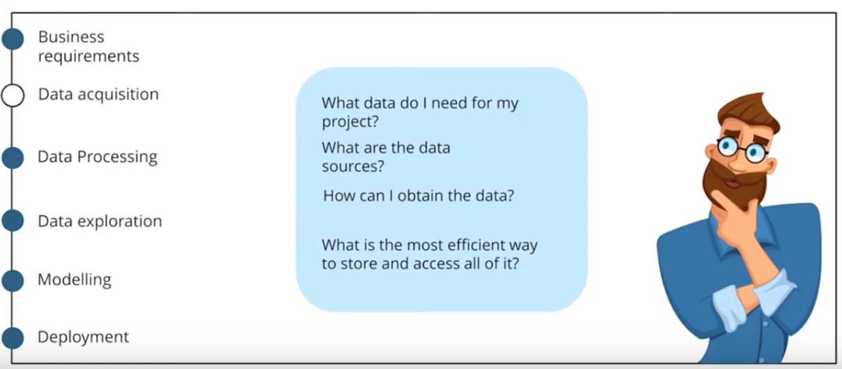
2. Data Acquisition

Slide 22
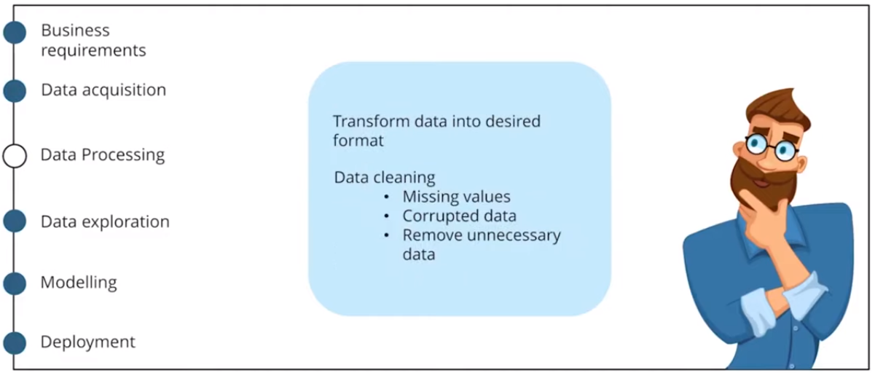
3. Data Processing

Slide 23
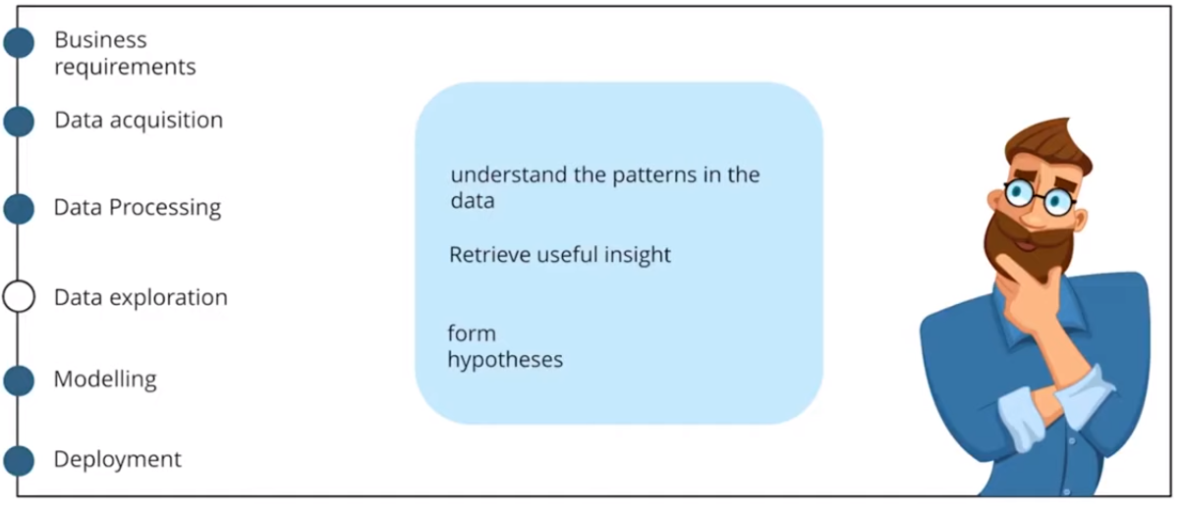
4. Data Exploration

Slide 24
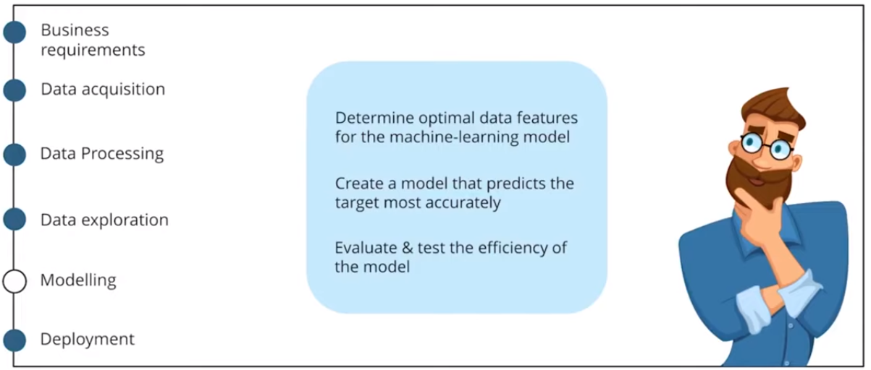
5. Modelling

Slide 25
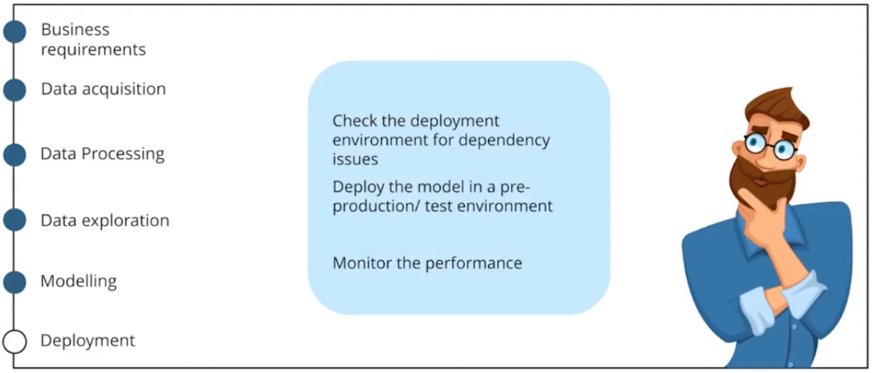
6. Deployment

Slide 26
Challenges of Data science Technology
High variety of information & data is required for accurate analysis
Not adequate data science talent pool available
Management does not provide financial support for a data science team
Unavailability of/difficult access to data
Data Science results not effectively used by business decision makers
Explaining data science to others is difficult
Privacy issues
Lack of significant domain expert
If an organization is very small, they can't have a Data Science team

Slide 27
Summary
Data Science is the area of study which involves extracting insights from vast amounts of data by the use of various scientific methods, algorithms, and processes.
Statistics, Visualization, Deep Learning, Machine Learning, are important Data Science concepts.
Data Science Process goes through Discovery, Data Preparation, Model Planning, Model Building, Operationalize, Communicate Results.
Important Data Scientist job roles are: 1) Data Scientist 2) Data Engineer 3) Data Analyst 4) Statistician 5) Data Architect 6) Data Admin 7) Business Analyst 8) Data/Analytics Manager
R, SQL, Python, SaS, are essential Data science tools
Important applications of Data science are 1) Internet Search 2) Recommendation Systems 3) Image & Speech Recognition 4) Gaming world 5) Online Price Comparison.
High variety of information & data is the biggest challenge of Data Science technology.

